Slide 1
Data and Signals

Slide 2

Note
To be transmitted, data must be transformed to electromagnetic signals.

Slide 3
3-1 ANALOG AND DIGITAL
Data can be analog or digital. The term analog data refers to information that is continuous; digital data refers to information that has discrete states. Analog data take on continuous values. Digital data take on discrete values.
Topics discussed in this section:
Analog and Digital Data
Analog and Digital Signals
Periodic and Nonperiodic Signals

Slide 4
Analog and Digital Data
Data can be analog or digital.
Analog data are continuous and take continuous values.
Digital data have discrete states and take discrete values.

Slide 5
Analog and Digital Signals
Signals can be analog or digital.
Analog signals can have an infinite number of values in a range.
Digital signals can have only a limited number of values.

Slide 6
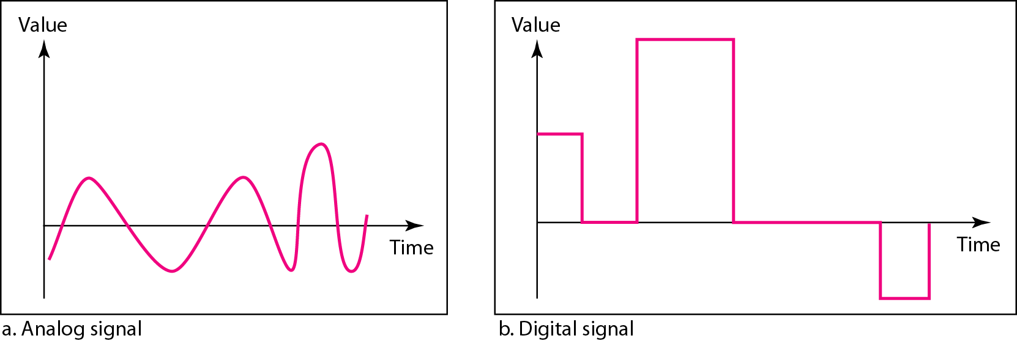
Figure 3.1 Comparison of analog and digital signals

Slide 7
3-2 PERIODIC ANALOG SIGNALS
In data communications, we commonly use periodic analog signals and nonperiodic digital signals.
Periodic analog signals can be classified as simple or composite. A simple periodic analog signal, a sine wave, cannot be decomposed into simpler signals. A composite
periodic analog signal is composed of multiple sine waves.
Topics discussed in this section:
Sine Wave
Wavelength
Time and Frequency Domain
Composite Signals
Bandwidth

Slide 8
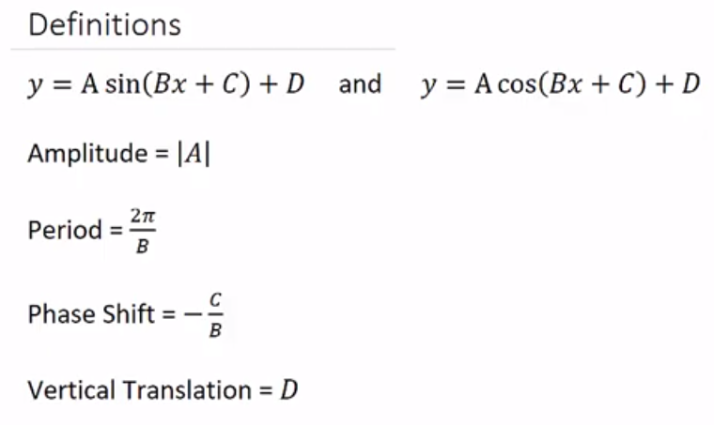
3-2 PERIODIC ANALOG SIGNALS

Slide 9
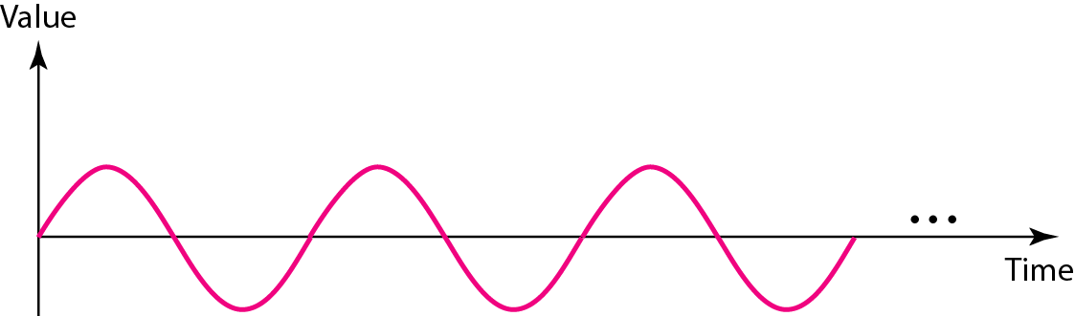
Figure 3.2 A sine wave

Slide 10
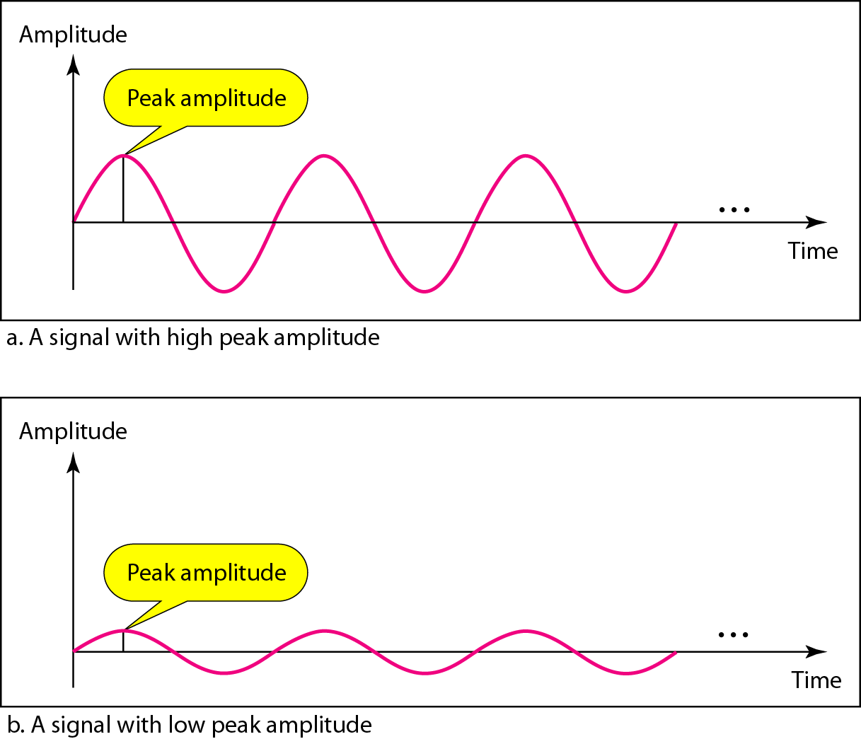
Figure 3.3 Two signals with the same phase and frequency, but different amplitudes

Slide 11

Note
Frequency and period are the inverse of each other.

Slide 12
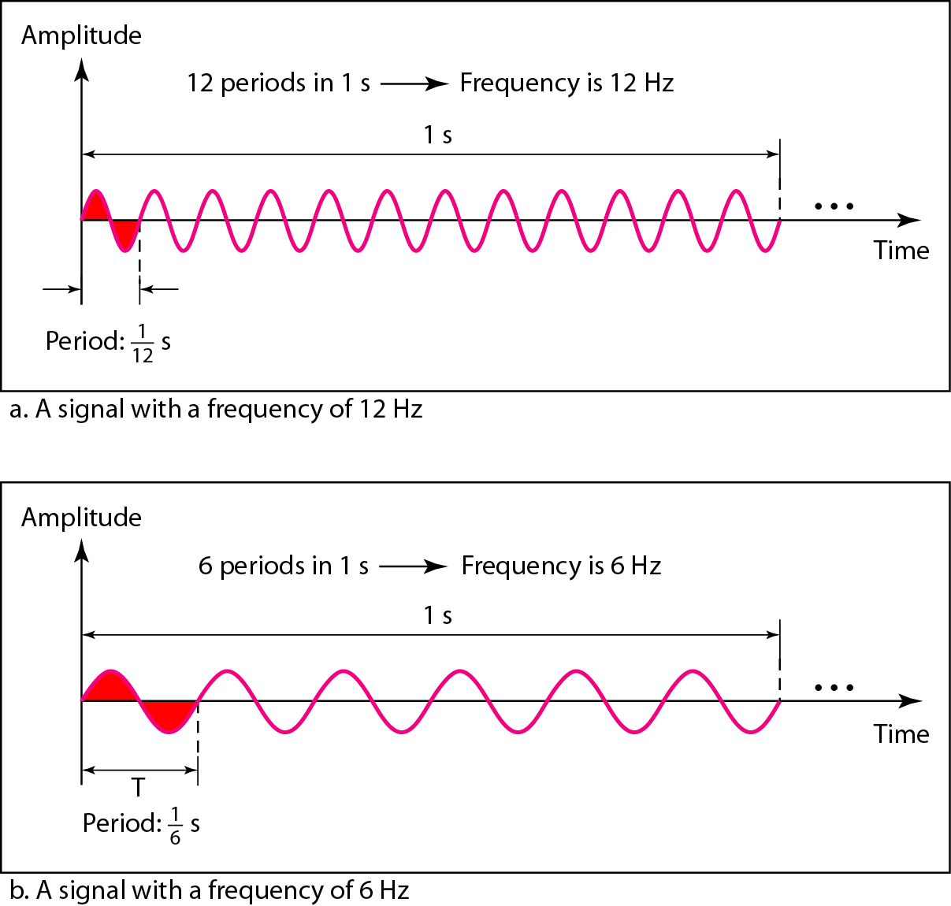
Figure 3.4 Two signals with the same amplitude and phase, but different frequencies

Slide 13
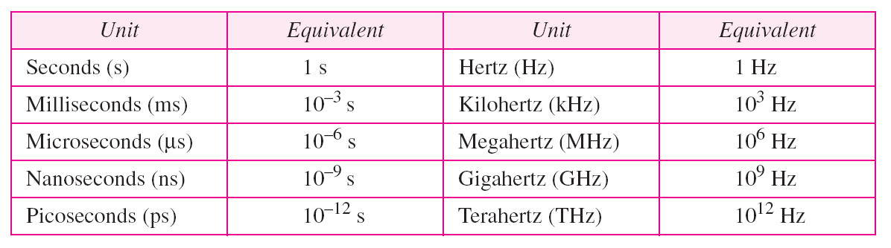
Table 3.1 Units of period and frequency

Slide 14
Example 3.1
The power we use at home has a frequency of 60 Hz. The period of this sine wave can be determined as follows:

Slide 15
Example 3.2
The period of a signal is 100 ms. What is its frequency in kilohertz?
Solution
First we change 100 ms to seconds, and then we calculate the frequency from the period (1 Hz = 10⁻³ kHz).

Slide 16
Frequency
Frequency is the rate of change with respect to time.
Change in a short span of time means high frequency.
Change over a long span of time means low frequency.

Slide 17
Note
If a signal does not change at all, its frequency is zero.
If a signal changes instantaneously, its frequency is infinite.

Slide 18
Note
Phase describes the position of the waveform relative to time 0.

Slide 19
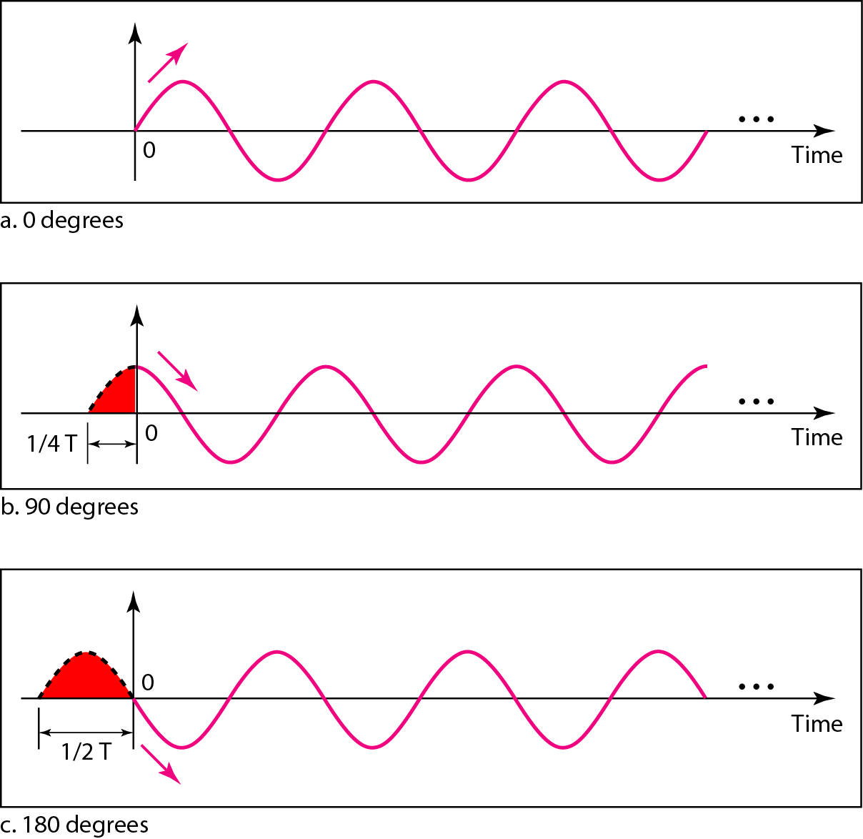
Figure 3.5 Three sine waves with the same amplitude and frequency, but different phases

Slide 20
Example 3.3
A sine wave is offset 1/6 cycle with respect to time 0. What is its phase in degrees and radians?
Solution
We know that 1 complete cycle is 360°. Therefore, 1/6 cycle is

Slide 21
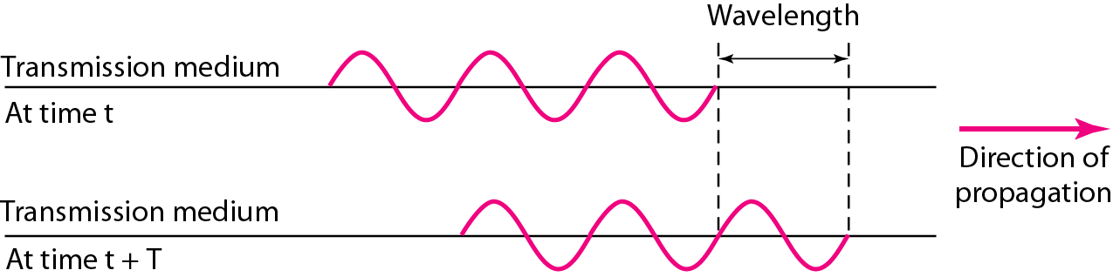
Figure 3.6 Wavelength and period

Slide 22
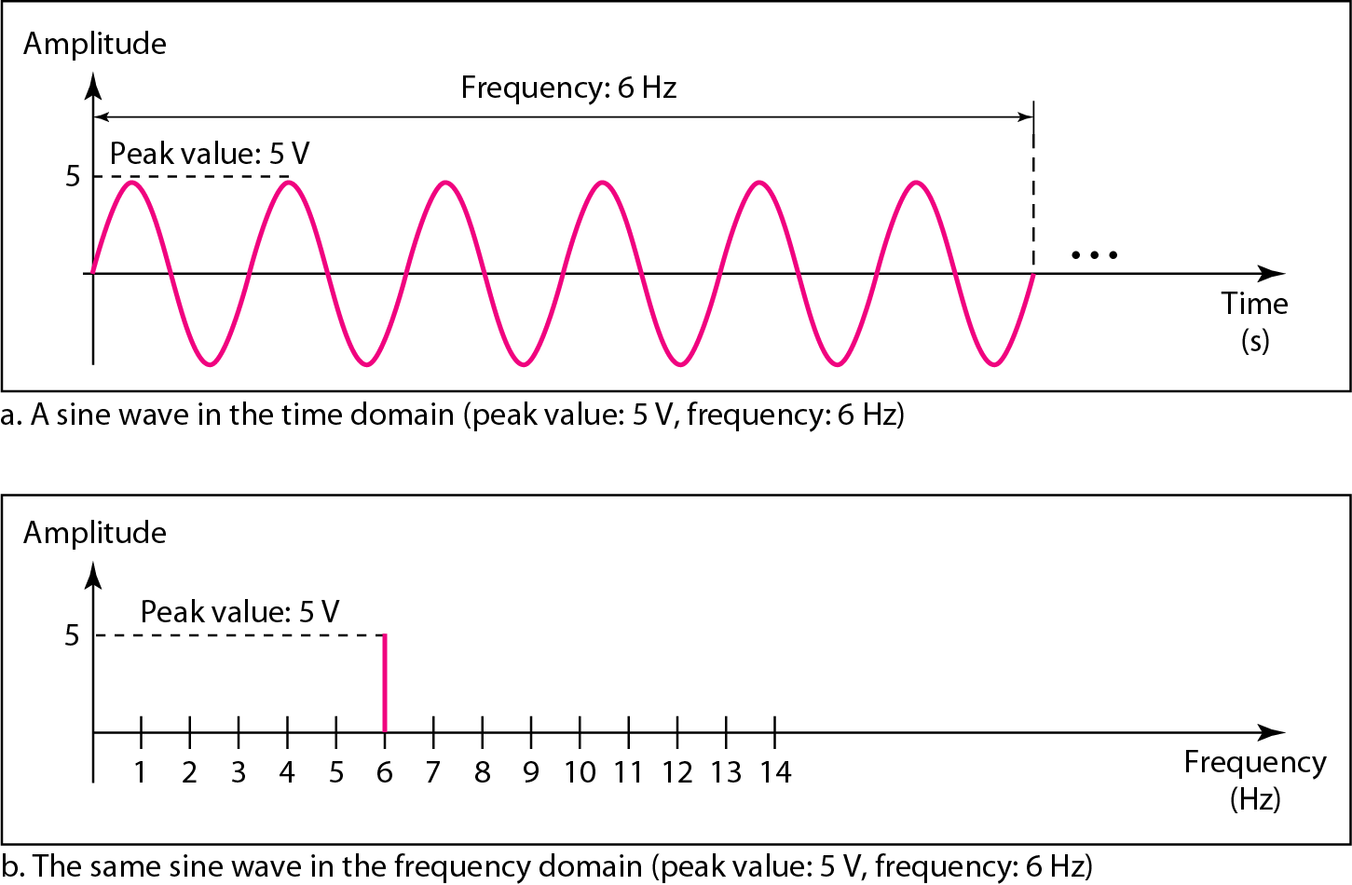
Figure 3.7 The time-domain and frequency-domain plots of a sine wave

Slide 23
Note
A complete sine wave in the time domain can be represented by one single spike in the frequency domain.

Slide 24
Example 3.7
The frequency domain is more compact and useful when we are dealing with more than one sine wave. For example, Figure 3.8 shows three sine waves, each with different amplitude and frequency. All can be represented by three spikes in the frequency domain.

Slide 25
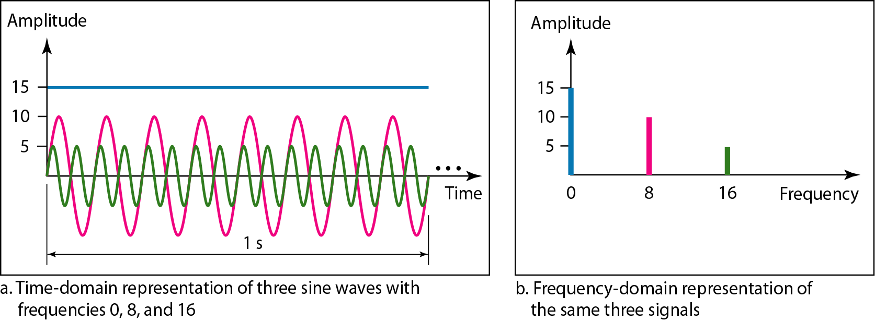
Figure 3.8 The time domain and frequency domain of three sine waves

Slide 26
Signals and Communication
A single-frequency sine wave is not useful in data communications
We need to send a composite signal, a signal made of many simple sine waves.
According to Fourier analysis, any composite signal is a combination of simple sine waves with different frequencies, amplitudes, and phases.

Slide 27
Composite Signals and Periodicity
If the composite signal is periodic, the decomposition gives a series of signals with discrete frequencies.
If the composite signal is nonperiodic, the decomposition gives a combination of sine waves with continuous frequencies.

Slide 28
Example 3.4
Figure 3.9 shows a periodic composite signal with frequency f. This type of signal is not typical of those found in data communications. We can consider it to be three alarm systems, each with a different frequency. The analysis of this signal can give us a good understanding of how to decompose signals.

Slide 29
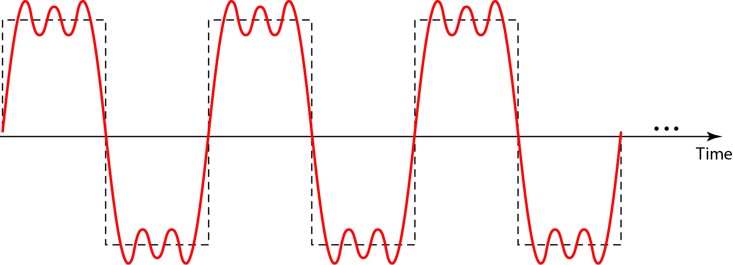
Figure 3.9 A composite periodic signal

Slide 30
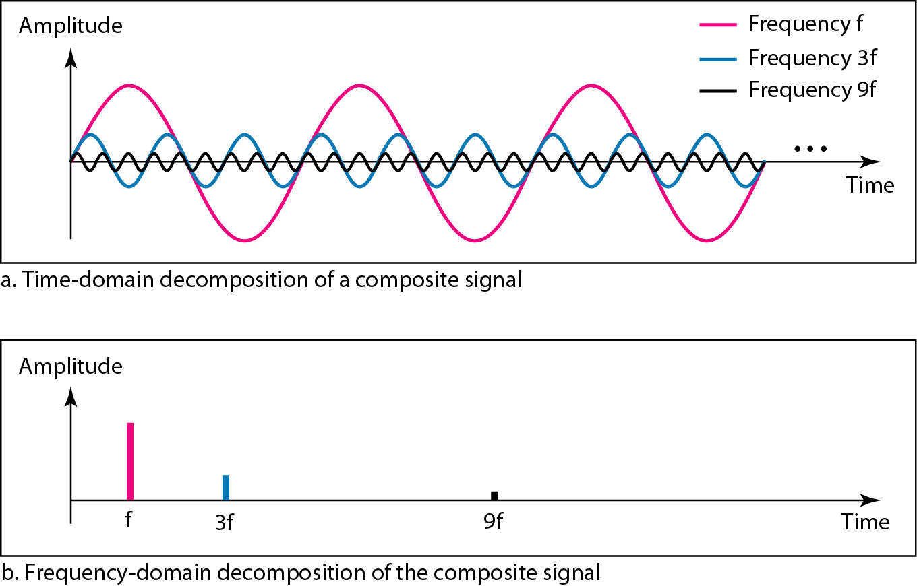
Figure 3.10 Decomposition of a composite periodic signal in the time and frequency domains

Slide 31
Example 3.5
Figure 3.11 shows a nonperiodic composite signal. It can be the signal created by a microphone or a telephone set when a word or two is pronounced. In this case, the composite signal cannot be periodic, because that implies that we are repeating the same word or words with exactly the same tone.

Slide 32
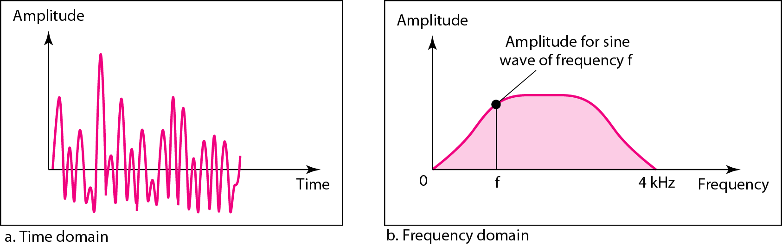
Figure 3.11 The time and frequency domains of a nonperiodic signal

Slide 33
Bandwidth and Signal Frequency
The bandwidth of a composite signal is the difference between the highest and the lowest frequencies contained in that signal.

Slide 34
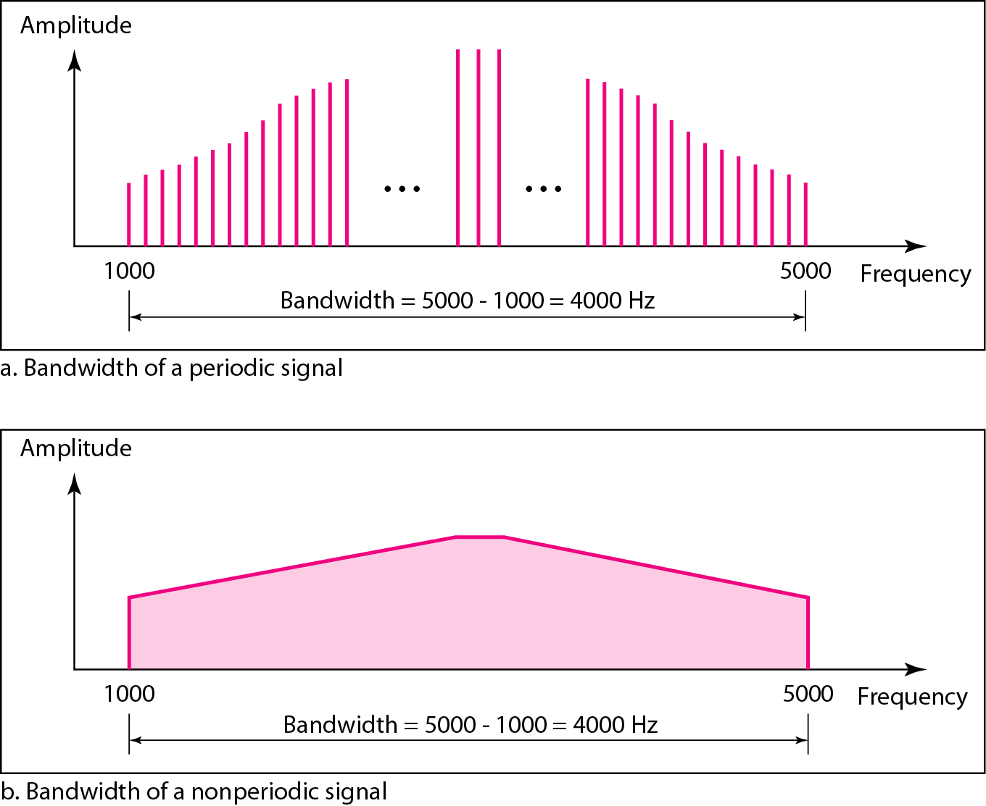
Figure 3.12 The bandwidth of periodic and nonperiodic composite signals

Slide 35
Example 3.6
If a periodic signal is decomposed into five sine waves with frequencies of 100, 300, 500, 700, and 900 Hz, what is its bandwidth? Draw the spectrum, assuming all components have a maximum amplitude of 10 V.
Solution
Let f_{h} be the highest frequency, f_{l} the lowest frequency, and B the bandwidth. Then
The spectrum has only five spikes, at 100, 300, 500, 700, and 900 Hz (see Figure 3.13).

Slide 36
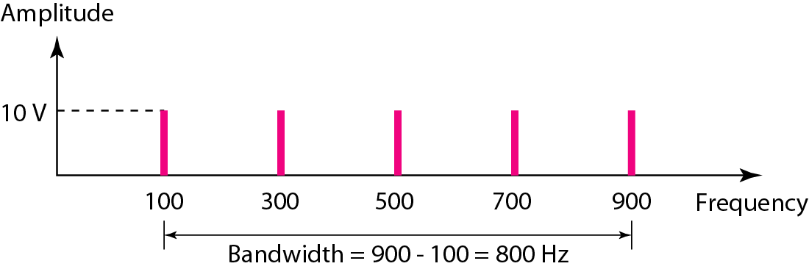
Figure 3.13 The bandwidth for Example 3.6

Slide 37
Example 3.7
A periodic signal has a bandwidth of 20 Hz. The highest frequency is 60 Hz. What is the lowest frequency? Draw the spectrum if the signal contains all frequencies of the same amplitude.
Solution
Let f_{h} be the highest frequency, f_{l} the lowest frequency, and B the bandwidth. Then
The spectrum contains all integer frequencies. We show this by a series of spikes (see Figure 3.14).

Slide 38
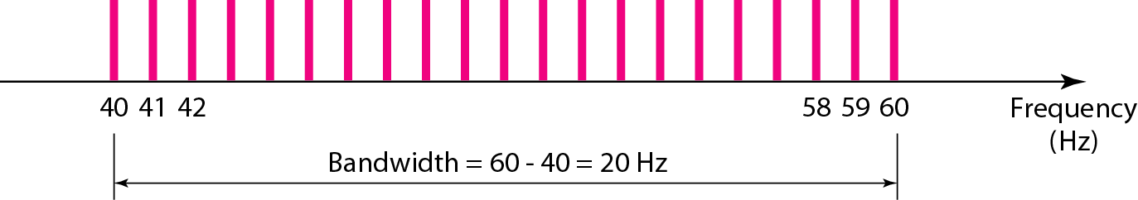
Figure 3.14 The bandwidth for Example 3.7

Slide 39
Example 3.8
A nonperiodic composite signal has a bandwidth of 200 kHz, with a middle frequency of 140 kHz and peak amplitude of 20 V. The two extreme frequencies have an amplitude of 0. Draw the frequency domain of the signal.
Solution
The lowest frequency must be at 40 kHz and the highest at 240 kHz. Figure 3.15 shows the frequency domain and the bandwidth.

Slide 40
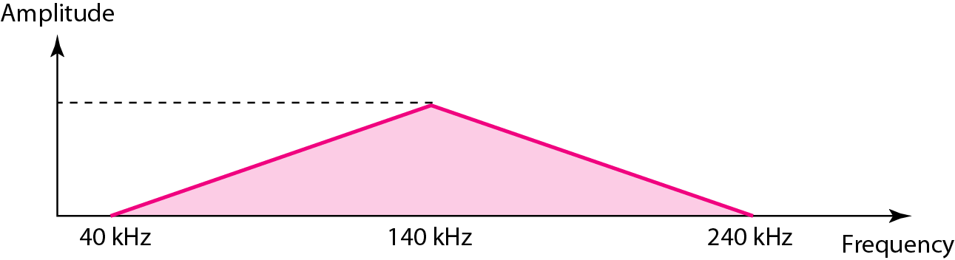
Figure 3.15 The bandwidth for Example 3.8

Slide 41
Example 3.9
An example of a nonperiodic composite signal is the signal propagated by an AM radio station. In the United States, each AM radio station is assigned a 10-kHz bandwidth. The total bandwidth dedicated to AM radio ranges from 530 to 1700 kHz. We will show the rationale behind this 10-kHz bandwidth in Chapter 5.

Slide 42
Example 3.10
Another example of a nonperiodic composite signal is the signal propagated by an FM radio station. In the United States, each FM radio station is assigned a 200-kHz bandwidth. The total bandwidth dedicated to FM radio ranges from 88 to 108 MHz. We will show the rationale behind this 200-kHz bandwidth in Chapter 5.

Slide 43
Example 3.11
Another example of a nonperiodic composite signal is the signal received by an old-fashioned analog black-and-white TV. A TV screen is made up of pixels. If we assume a resolution of 525 × 700, we have 367,500 pixels per screen. If we scan the screen 30 times per second, this is 367,500 × 30 = 11,025,000 pixels per second. The worst-case scenario is alternating black and white pixels. We can send 2 pixels per cycle. Therefore, we need 11,025,000 / 2 = 5,512,500 cycles per second, or Hz. The bandwidth needed is 5.5125 MHz.

Slide 44
Fourier Analysis
Note
Fourier analysis is a tool that changes a time domain signal to a frequency domain signal and vice versa.

Slide 45
Fourier Series
Every composite periodic signal can be represented with a series of sine and cosine functions.
The functions are integral harmonics of the fundamental frequency “f” of the composite signal.
Using the series we can decompose any periodic signal into its harmonics.

Slide 46
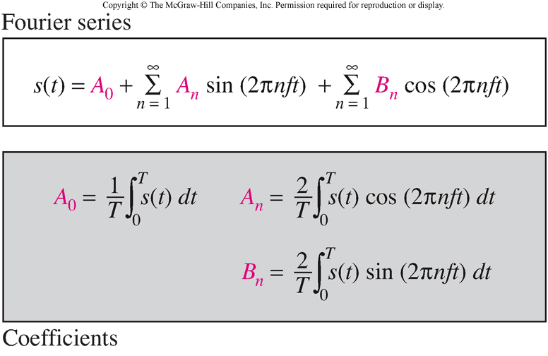
Fourier Series

Slide 47
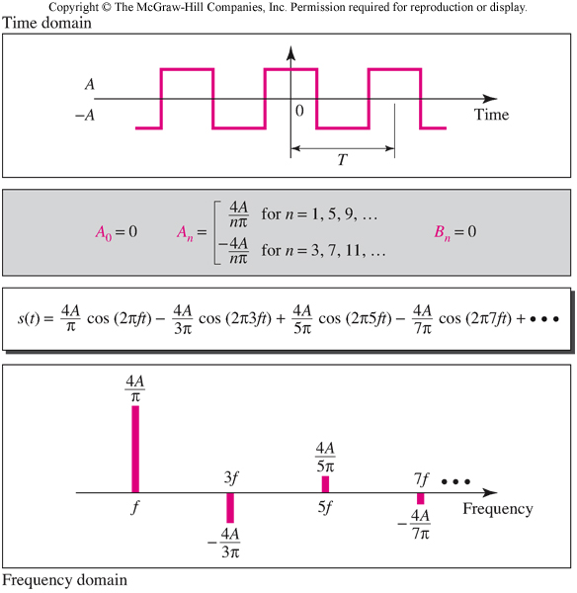
Examples of Signals and the Fourier Series Representation

Slide 48
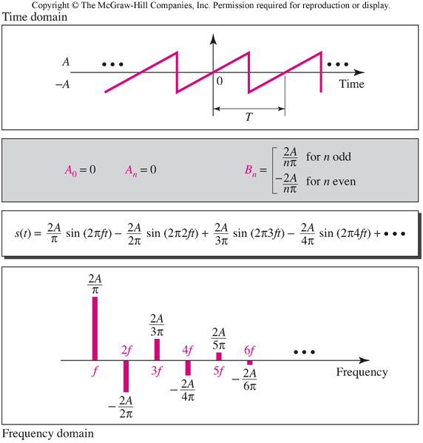
Sawtooth Signal

Slide 49
Fourier Transform
Fourier Transform gives the frequency domain of a nonperiodic time domain signal.

Slide 50
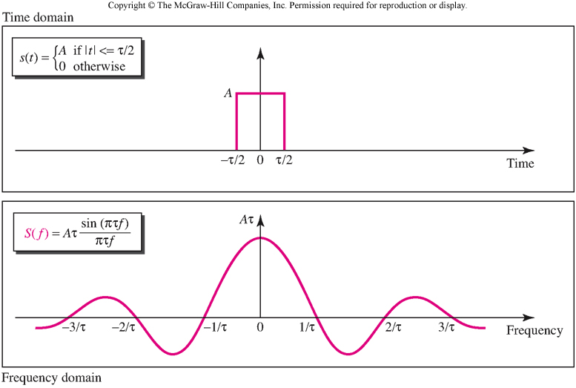
Example of a Fourier Transform

Slide 51
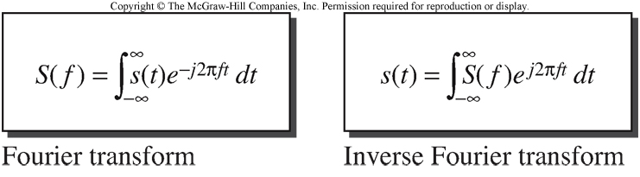
Inverse Fourier Transform

Slide 52
Time limited and Band limited Signals
A time limited signal is a signal for which the amplitude s(t) = 0 for t > T₁ and t < T₂
A band limited signal is a signal for which the amplitude S(f) = 0 for f > F₁ and f < F₂

Slide 53
Fourier Series Recap

Slide 54
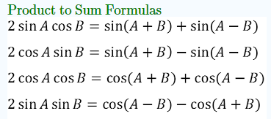
Some Math

Slide 55
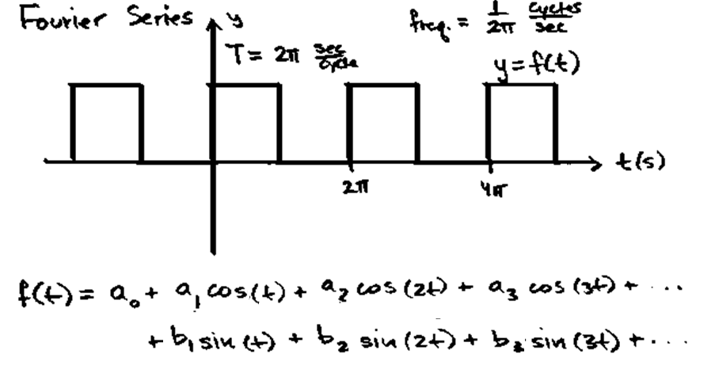

Slide 56
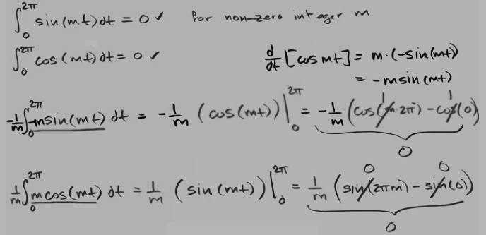

Slide 57

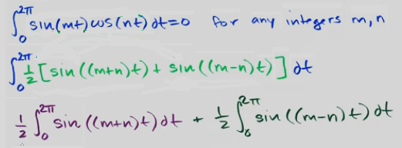


Slide 58
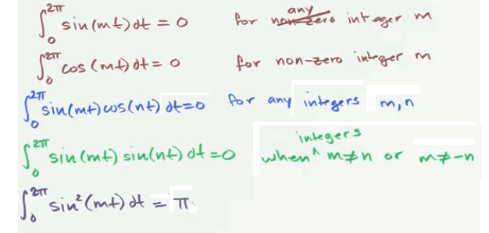
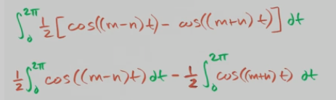

Slide 59




Slide 60
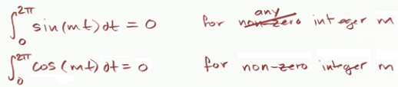

Slide 61
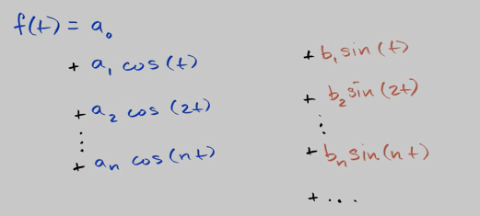
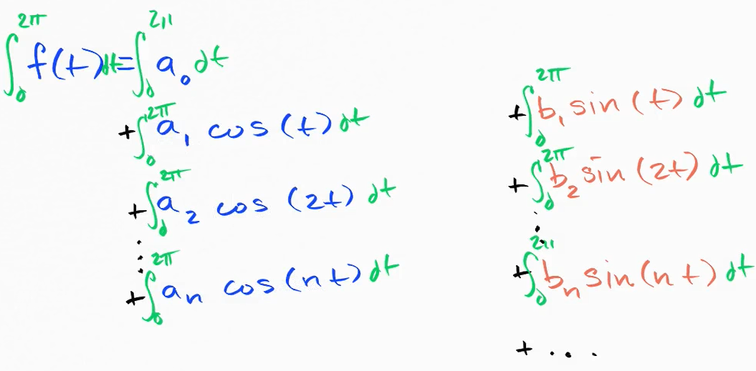

Slide 62
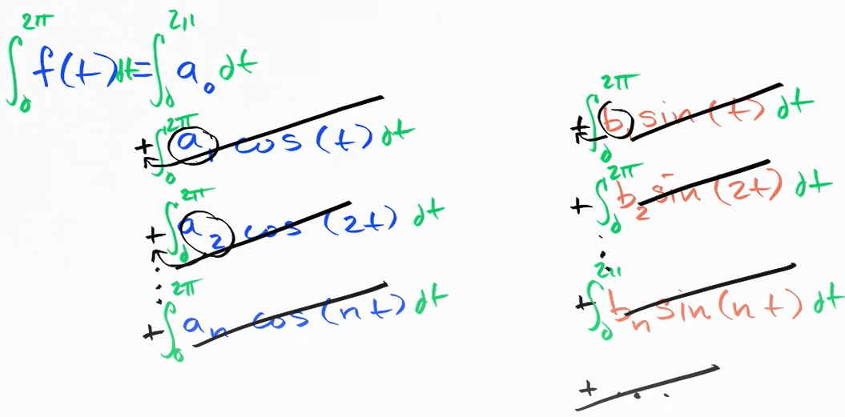

Slide 63
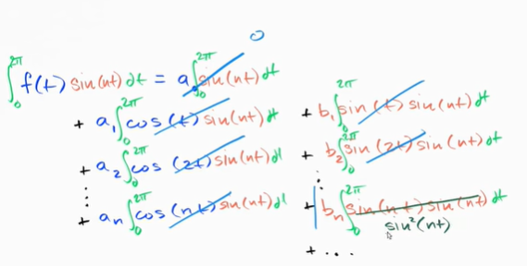

Slide 64
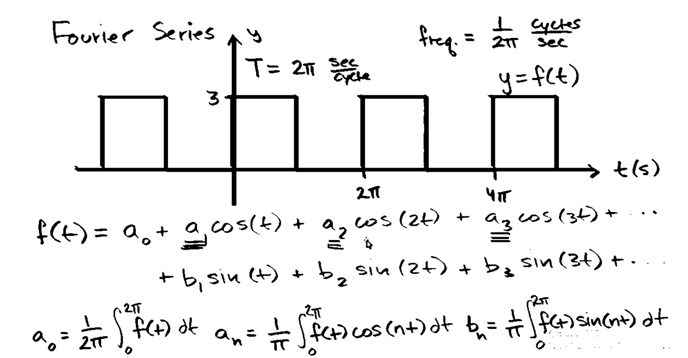

Slide 65
Fourier Series Recap

Slide 66
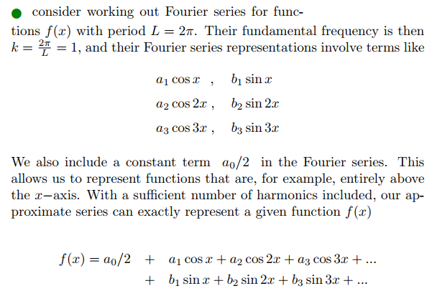
Fourier Series

Slide 67
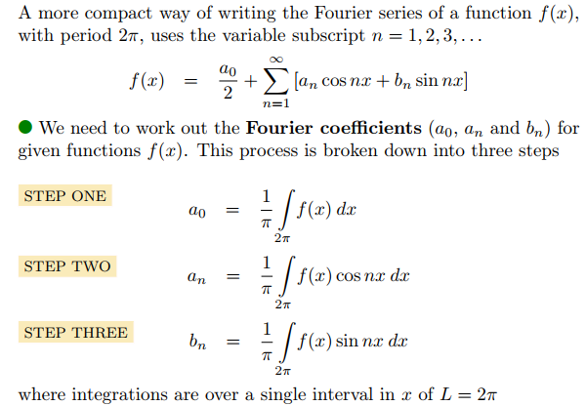

Slide 68
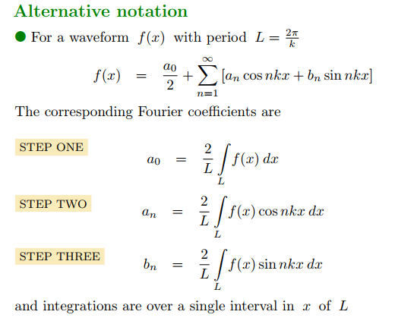

Slide 69
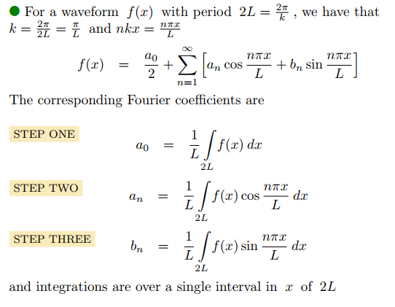

Slide 70
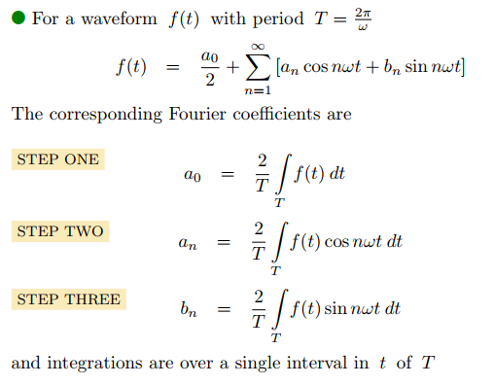

Slide 71
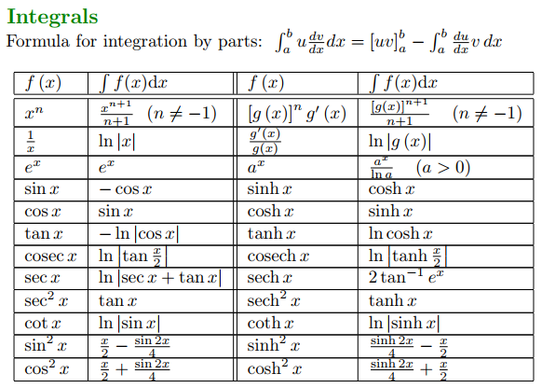
Recap formulas

Slide 72
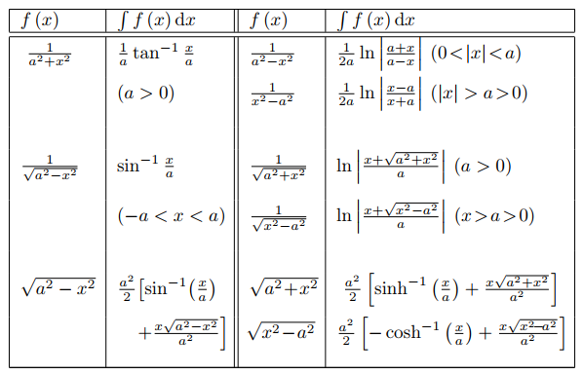

Slide 73
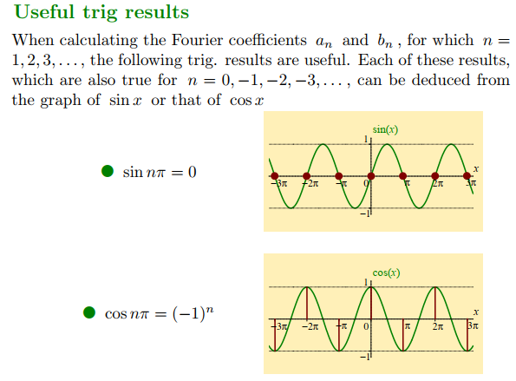

Slide 74
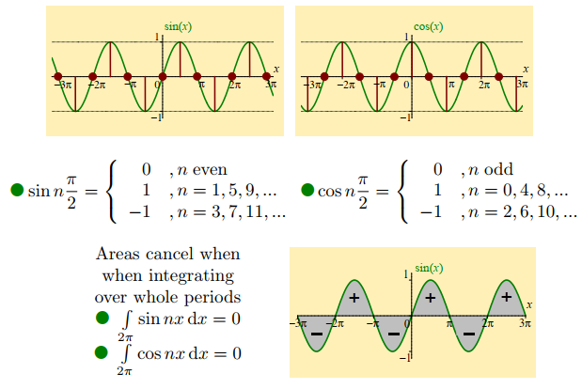

Slide 75
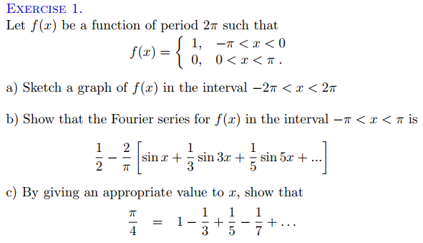
Exercises

Slide 76
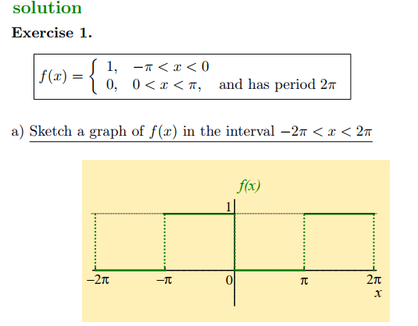

Slide 77
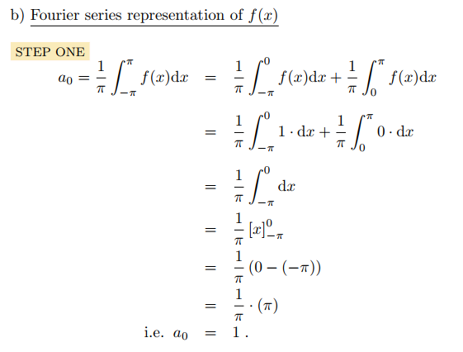

Slide 78
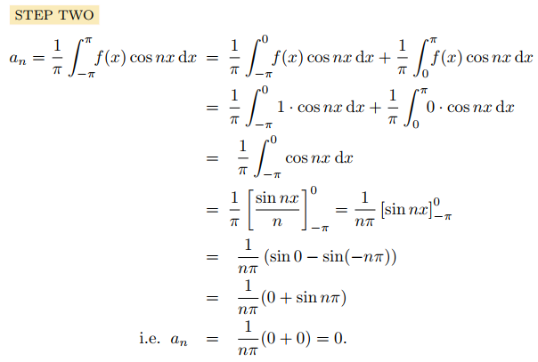

Slide 79
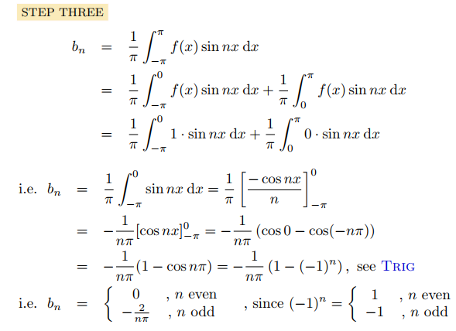

Slide 80
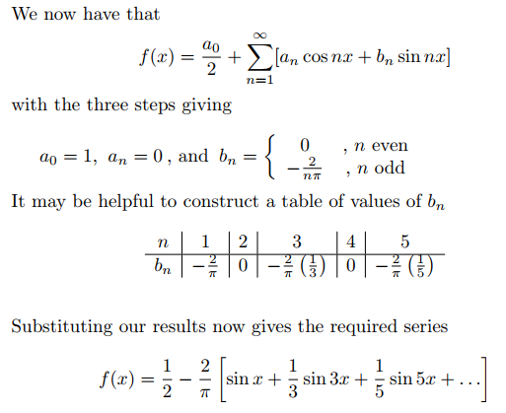

Slide 81
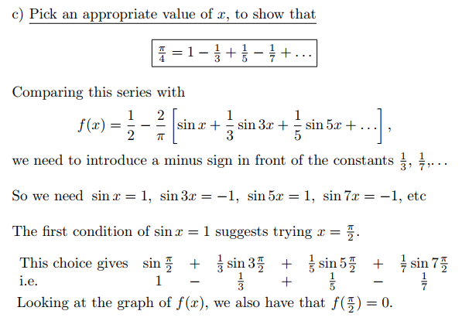

Slide 82


Slide 83

Exercise 2

Slide 84


Slide 85


Slide 86


Slide 87


Slide 88


Slide 89


